Slide 1

YOGI BEAR and all related characters and elements © & ™ Hanna-Barbera. (s23)

Slide 2

Points Import Instructions

Slide 3
This is training to import Points into Incentive Control for Members to receive points for cabin/sites, store, and other transactions.

Slide 4
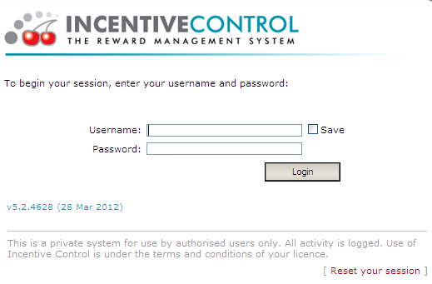
Points Import Instructions
Web-based Point Entry in Incentive Control
Login to Incentive Control (https://rp1.incentivecontrol.com) as you normally would

Slide 5
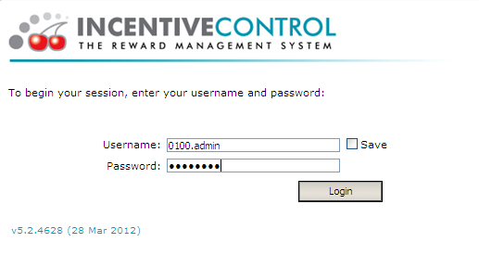
Points Import Instructions
Remember that the username is the 4 or 5-digit park number, then “.”, then “admin”). Enter password. And click “Login” button.

Slide 6
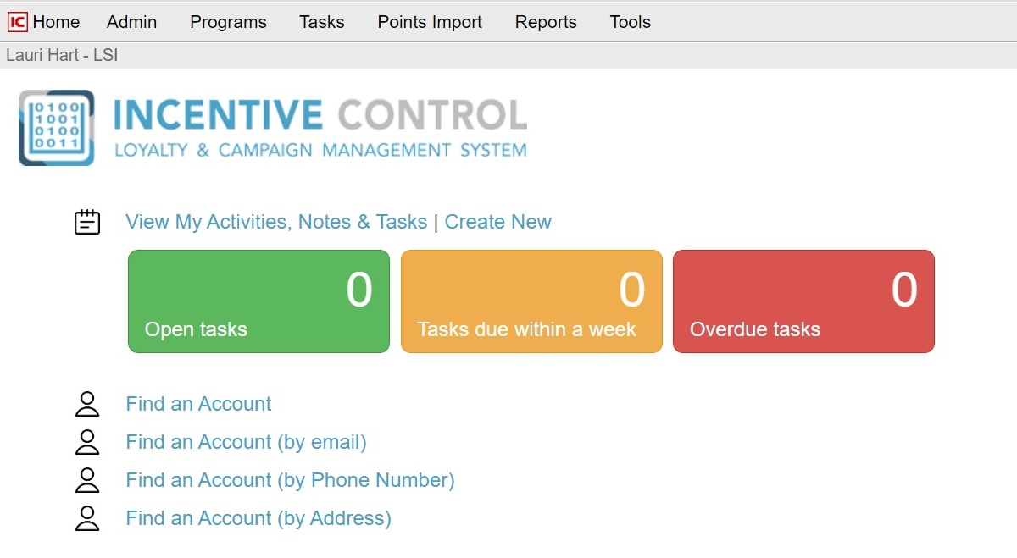
Points Import Instructions
There is a tab at top entitled “Points Import”

Slide 7
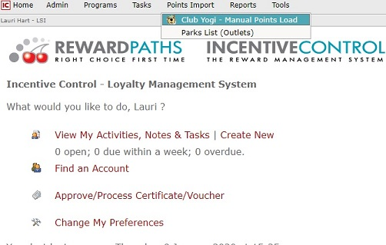
Points Import Instructions
Then from the drop-down menu, select “Club Yogi-Manual Points Load”

Slide 8
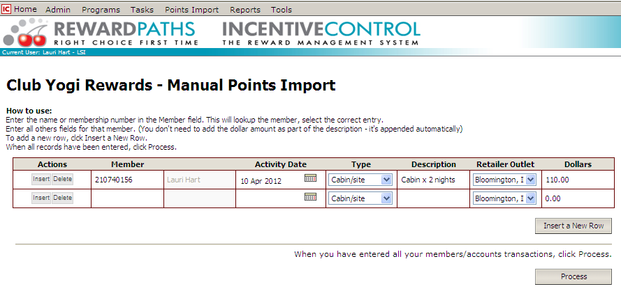
Points Import Instructions

Slide 9
Points Import Instructions
The instructions for entry are at the top of the web page.
Enter member name or Club Yogi Rewards number –it will lookup by either and select the correct one when it comes up. Be sure your cursor is not below the member number or member name.
Enter the date of the transaction (be sure you have selected the correct year). For cabin/sites, the transaction date will be the departure date. You will have to go back several times to select year, then month, and date from the calendar drop down
Select what type of transaction (Cabin/Site, Store or Other)
Add a description on the type of site and the dates of stay (WES Site May 23-24). Also, add a description if you have selected the Other category (.ie. golf cart rental, wristbands, guest fee, etc.).
For store purchases, you can total the transactions for the stay and put in the description “POS” and enter date range
Select your Park (it should come up automatically)
Then enter the dollar amount (all amounts are before tax)
To add another transaction or member, then insert new row
When finished, select process. The transaction will post in real time.

Slide 10
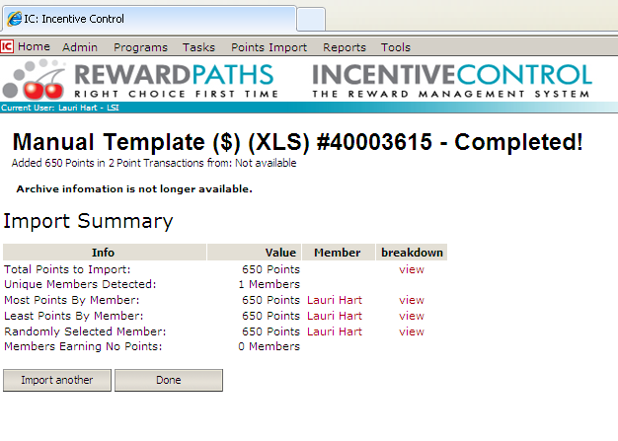
Points Import Instructions
Once the “Process” button is clicked, the points are automatically posted to the account. This summary screen comes up:

Slide 11
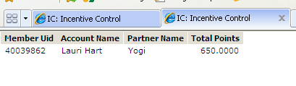
Points Import Instructions
There is a breakdown on the far right, select view, and the detail will come up of the points that were entered by member.

Slide 12
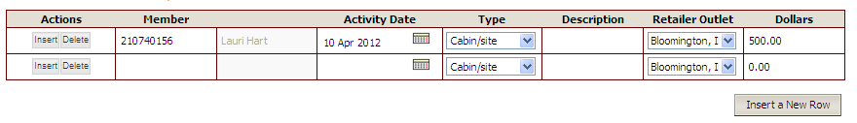
Points Import Instructions
If a mistake is made while entering, this is easy to correct (by deleting the transaction line).

Slide 13
Points Import Instructions
However, if the “process” button has been clicked, and the summary screen has appeared, then Camp Jellystone will need to make the corrections. Contact Lauri to request these corrections (Lhart@campjellystone.com)
Common mistakes are :
The wrong member entered
Incorrect date (especially year)
Incorrect transaction type (“cabin/site” selected for golf cart rental instead of “other”)

Slide 14
Points Import Instructions
Be sure to enter transactions in small batches, the system will time out if the process button is not selected in a timely manner
If you have any questions about this training, or if you have forgotten your login information for Incentive Control, then please contact Lauri Hart, Lhart@campjellystone.com, or 248-905-1943.

Slide 15

YOGI BEAR and all related characters and elements © & ™ Hanna-Barbera. (s23)

